Slide 1
Salt Lake City Chamber of Commerce
By Sterling Welker

Slide 2





Domain Name & Logo
Domain:
SaltLakeChamber.com

Slide 3
Site Purpose
Our site purpose here at the Salt Lake City Chamber of Commerce, is to work together to build a healthy economy and improve the quality of life in our community. We do this, by providing local businesses with resources and an environment where they can grow and prosper. Within this website, we help our users to learn more about how to join the Chamber of Commerce with its many benefits, and by highlighting local businesses and upcoming events.

Slide 4
Target Audience
Our target audience will be current and prospective members of the Salt Lake City Chamber of Commerce. While there may be some users that come here to learn more about their local community, that will not be our focus. Our focus is on helping business owners grow their businesses. We do not have an age range for our target audience, as there is no age limit for starting a business. However, we want to make our site as easily accessible as possible since some members of our target audience may not have the same level of technological experience.

Slide 5
Personas
Samantha and Robert Jacobson
Samantha (32-year-old female) and Robert (34-year-old male), are a married couple who recently moved to Salt Lake City with their 3 children. They moved to Salt Lake City as they own a couple of BBQ restaurants in Arizona and are in the process of opening a new restaurant here. They were already members of the Chamber of Commerce in Phoenix, Arizona, but are now looking to join the Salt Lake City Chamber as their new restaurant is two months away from their grand opening. They would like to advertise this grand opening, through the Chamber of Commerce.
Aaron Baynes
Aaron (27-year-old male) lives in Salt Lake City. He and two of his old college roommates started a landscaping coming 3 years ago and joined the Salt Lake City Chamber of Commerce 1 year ago. Up until now, they had only done residential landscaping, but are now planning on expanding to do business landscaping as well. He and his friends (co-owners) would like to begin networking with other companies as they continue to expand their business.

Slide 6
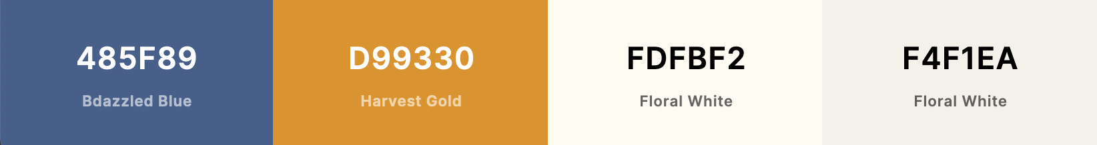
Color Scheme & Typography
Primary Accent Background Background Accent
Headers & Titles: Montserrat Medium 500
Main body text: Roboto Regular 400

Slide 7
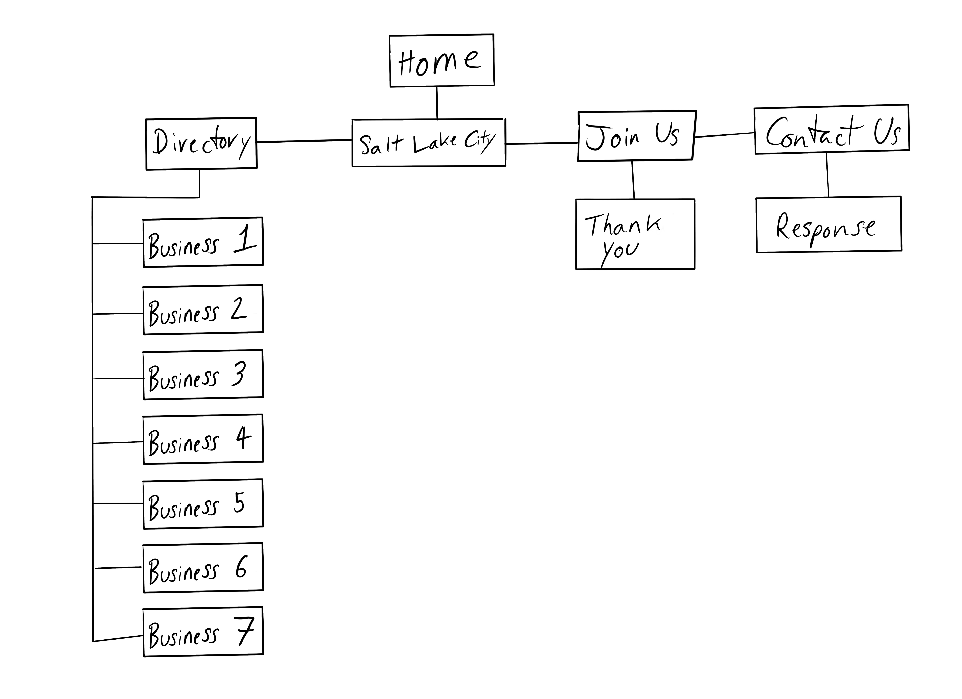
Site Map

Slide 8
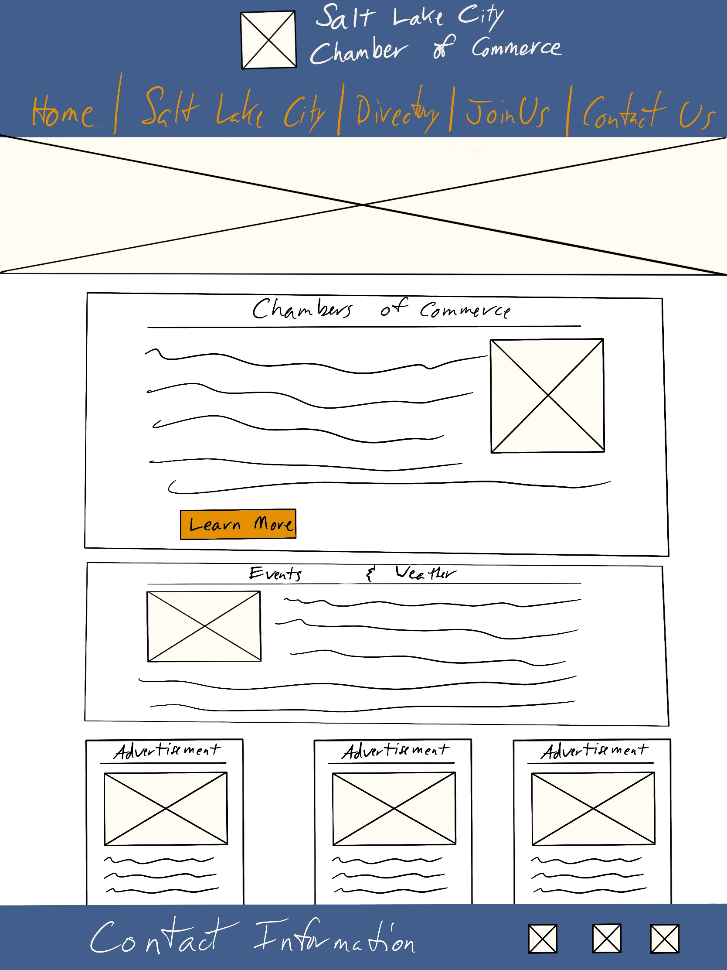
Large Wireframe

Slide 9
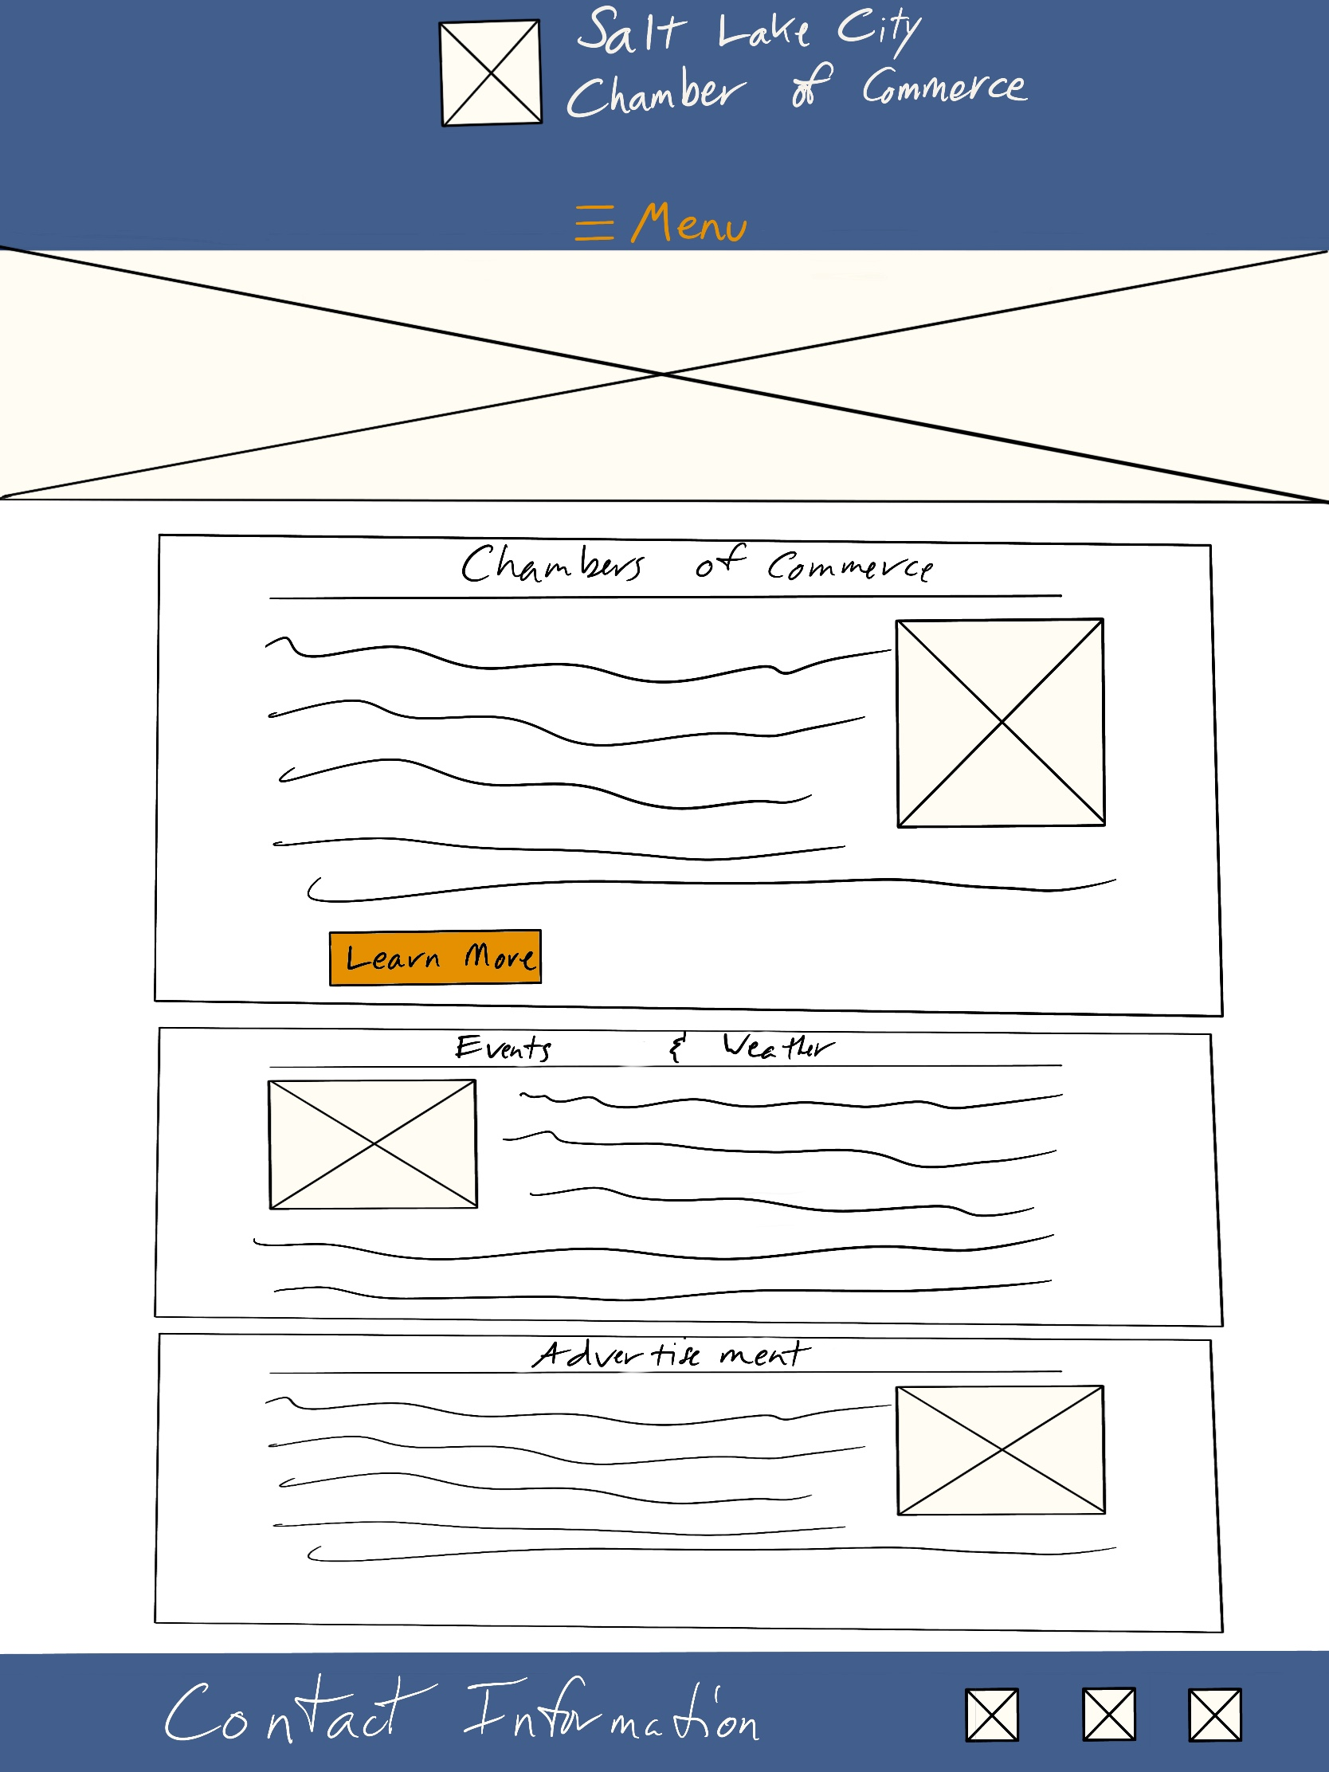
Medium Wireframe

Slide 10
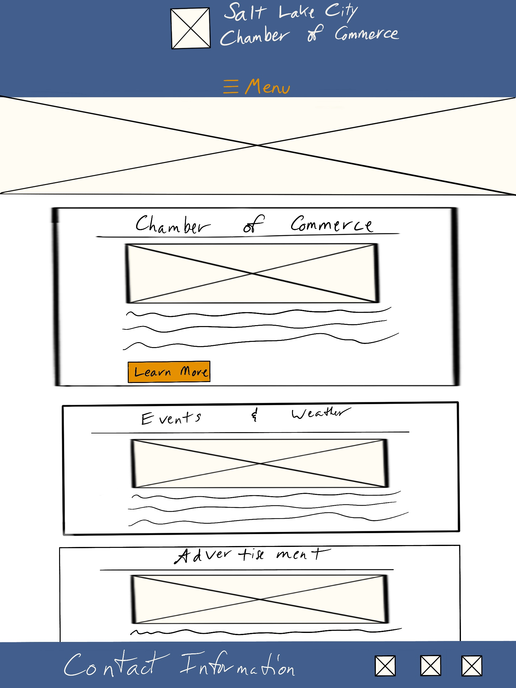
Small Wireframe

